Slide 1
Operating Systems
SENS-3513
Week: 07
Threads
Operating System Concepts
9th edition
Silberschatz, Galvin & Gagne
John Wiley & Sons
2013
Dr Nauman Mazhar
Faculty of Information Technology (FIT)
University of Central Punjab (UCP)

Slide 2
Objectives
Flow of execution, & Execution context
What is a Thread
Single-threaded vs Multi-threaded processes
Threads vs Processes
Threads benefits, & disadvantages
User level & Kernel level threads
Multithreading Models
  M:1, 1:1, M:N
Threads implementation (pthreads library)
Threads issues
2

Slide 3
Instruction Execution
Addr 2³²-1
R0
…
R31
PC
Stack
…
Data1
Data0
Inst237
Inst236
…
Inst4
Inst3
Inst2
Inst1
Inst0
Fetch
Exec
Fetch instruction at PC
Decode
Execute - possibly using registers
Write results to registers/mem
PC = Next instruction
PC
PC
PC
PC
Addr 0
3

Slide 4
Flow of Execution & Execution Context
“Every process has a unique flow of execution
& execution context”
Flow of Execution (Flow of Control)
  “sequence in which program instructions are executed”
  path taken by a program, from start till end of execution
  (includes branches, function calls, etc)
Execution Context
“state of the program, at a specific point in time,
during its execution”
  values of program variables – Stack, Heap
  contents of CPU registers – PC, SP, FP, PSW, gen purpose regs
  state of open files, other I/O operations
4

Slide 5
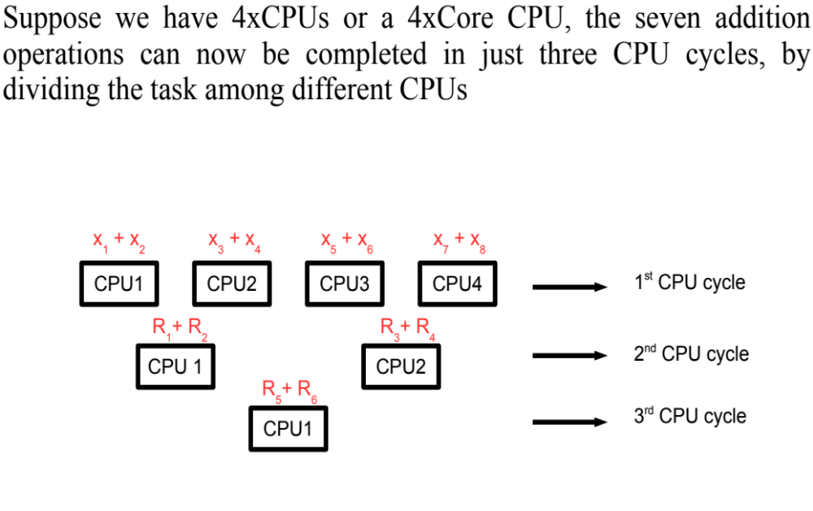
Sequential, Parallel, Concurrent Execution
Sequential Execution
adding eight numbers needs seven addition operations
x₁+ x₂ + x₃+ x₄+ x₅+ x₆+ x₇+ x₈
if one addition uses one CPU cycle → 7 CPU cycles in total
Parallel Execution
with 4 CPUs (or 4 Core CPU)
addition will take
3 CPU cycles
Concurrent Execution
Single CPU switches rapidly between processes (time-shared)
5

Slide 6
Multiple Flows of Execution
Concurrent & Parallel execution requires multiple flows of execution
How to have multiple flows of execution…
  create multiple processes in the system
    child processes, using fork()
  create Threads
    more efficient than processes – need to study
6

Slide 7
Threads
Process model, studied so far, assumed that:
  “A process is a program in execution,
  with a single flow of execution, or flow of control”
However, all modern OS allow a process to contain multiple flows of execution:
“Thread is a single flow of execution,
used to perform some particular task within a process”
If a process has multiple threads, it can perform more than one task concurrently (or in parallel)
  each thread performs a separate task
  (update display, fetch data, spell check, answer network request)
7

Slide 8
Single Threaded Process
An example of a process with a single thread
Thread
main()
{
…
f1(…);
…
f2(…);
…
}
f1(…)
{ … }
f2(…)
{ … }
f1
f2
Process Terminated
8

Slide 9
Multi Threaded Process
main() function is executed by one thread, while f1 & f2 are executed by separate threads
main()
{
…
thread(t1,f1);
…
thread(t2,f2);
…
}
f1(…)
{ … }
f2(…)
{ … }
Process Address Space
main
t1
t2
PC
PC
PC
9

Slide 10
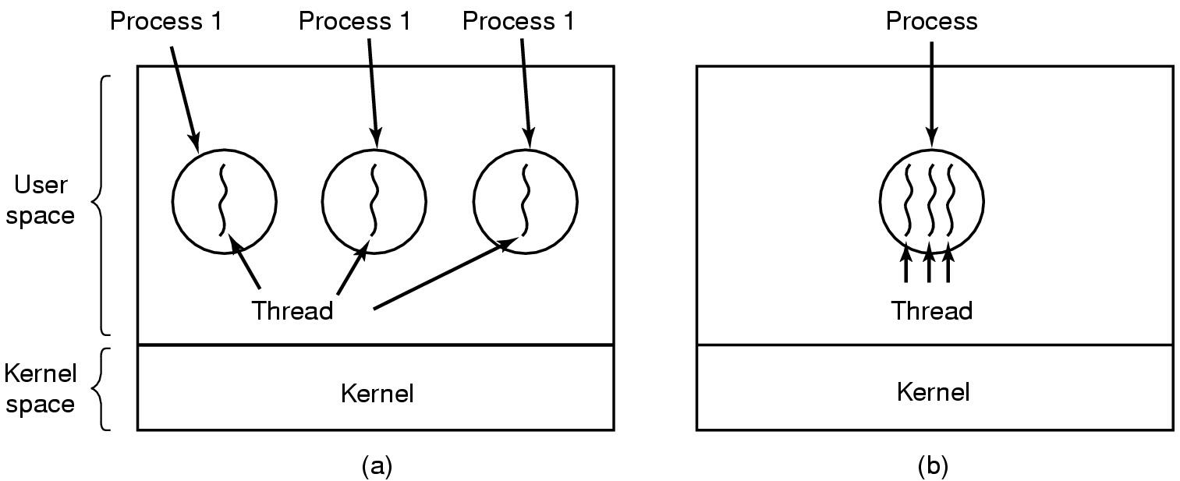
Single & Multithreaded Process
Process 1
Process 2
Process 3
Three processes,
each with one thread
One process,
with three threads
10

Slide 11
Threads
“Thread is the basic unit of CPU utilization”
Thread is the entity that is scheduled for execution on CPU
Thread has same address space as the process that created it
A thread has its own:
  Thread ID Program counter value (PC)
  Stack Register set (CPU registers)
Thread shares following with other threads in same process:
PID, text section, data section, heap, open files, etc
Can see thread IDs in shell → ps -eLf
“Thread is an execution context,
scheduled independently, but shares a single address space
with other threads of the same process”
11

Slide 12
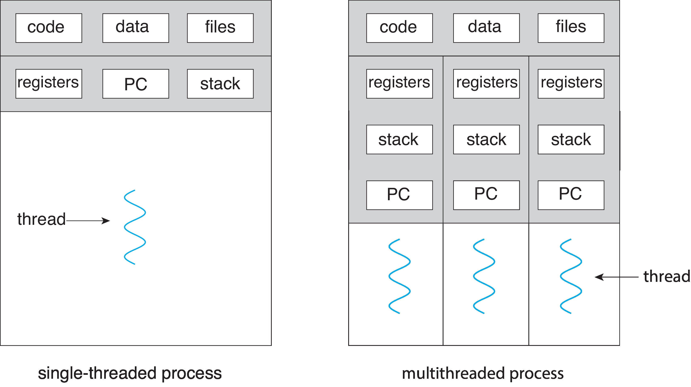
Single & Multithreaded Processes
12
Notes:
Read Comparisons on book page 96

Slide 13
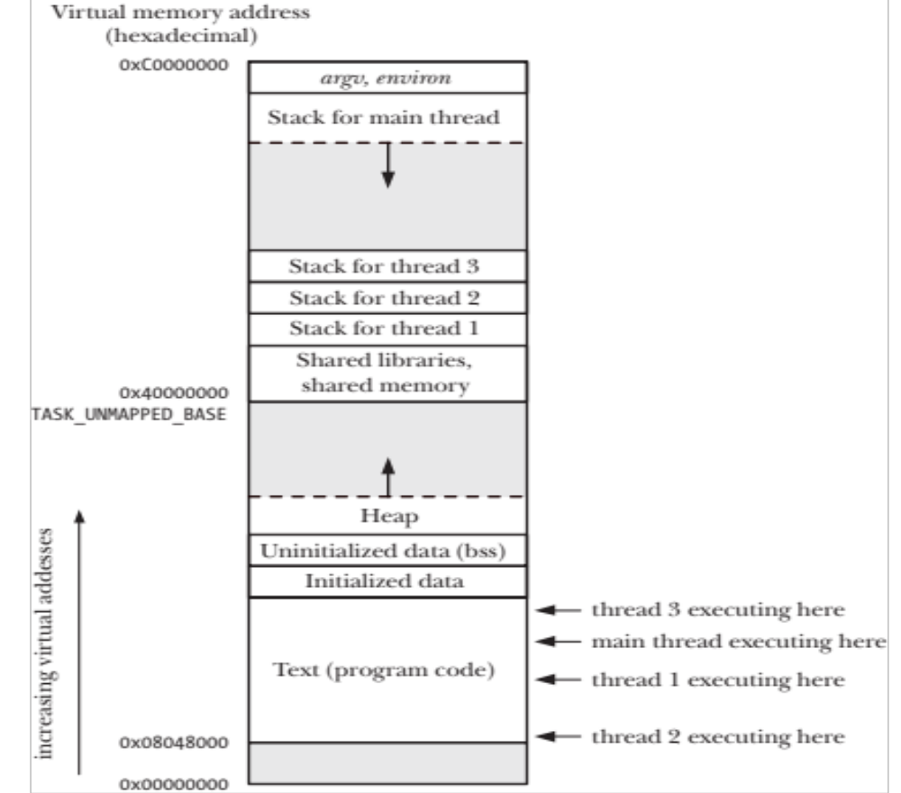
Execution of Threads
Register Set managed thru context switching
Stack for each thread
PC for each thread
13

Slide 14
Multi-threading
“Multi-threading is the ability of an OS
to support multiple flows of execution (execution contexts)
within a single process”
Multi-threading works similar to multi-tasking
  CPU switches rapidly, back & forth, among threads
  provides the illusion that threads are running in parallel
  in reality, threads are running concurrently – concurrent execution
Most modern applications are multithreaded
Kernels are generally multithreaded
14

Slide 15
Ways to Achieve Concurrency
Multiple Processes – single threaded
  create child processes using fork(), to handle new tasks
  good if each child can operate in isolation
  would need IPC between processes
  process creation utilizes a lot of memory & time
Multiple Threads – within a single process
  create threads in a single process, to handle new tasks
  good if child threads need to share data
  no IPC required
  thread creation is low cost
  “Thread is regarded as a light-weight process”
15

Slide 16
Threads vs Processes
Similarities
Like processes, threads can also be in one of many states
  (new, ready, running, blocked, terminated)
  only one thread in running state (on single CPU systems)
Threads can also create other child threads
Differences
Every process has its own address space
  while all threads within a process, operate within the
  same address space
No “automatic” memory protection mechanism between threads
  threads are meant to help each other
16

Slide 17
Benefits of Threads
Responsiveness
  Multi-threaded server allows interaction with users while another thread formulates response to a previous user query
Resource Sharing
  Process resources (code, data, etc) are shared by all threads
  OS resources (PCB, PPFDT, etc) are also shared by all threads
Economy of Effort
  Takes less time to create, schedule, & terminate a thread
  Solaris 2: Thread creation 30 times faster than process creation
  Thread switching is 5 times faster than process switching
Performance
  In multi-threaded & multi-processor architectures, each thread may run on a different processor (in parallel)
17

Slide 18
Disadvantages of Threads
Problems due to Shared Memory
  Race Conditions – try to modify shared data
  need to implement Mutual Exclusion, if multiple threads need to access shared data for write/update
Many library functions are not Thread-Safe
  some functions use shared global or static data
    access by multiple threads may cause data inconsistency
  need synchronization, when using non-thread-safe functions
  thread-safe functions avoid shared data, or use synchronization
Lack of Robustness
  A severe error caused by one thread (e.g, segmentation fault) terminates the whole process
18
Notes:
What do you mean by a Thread Safe function?

Slide 19
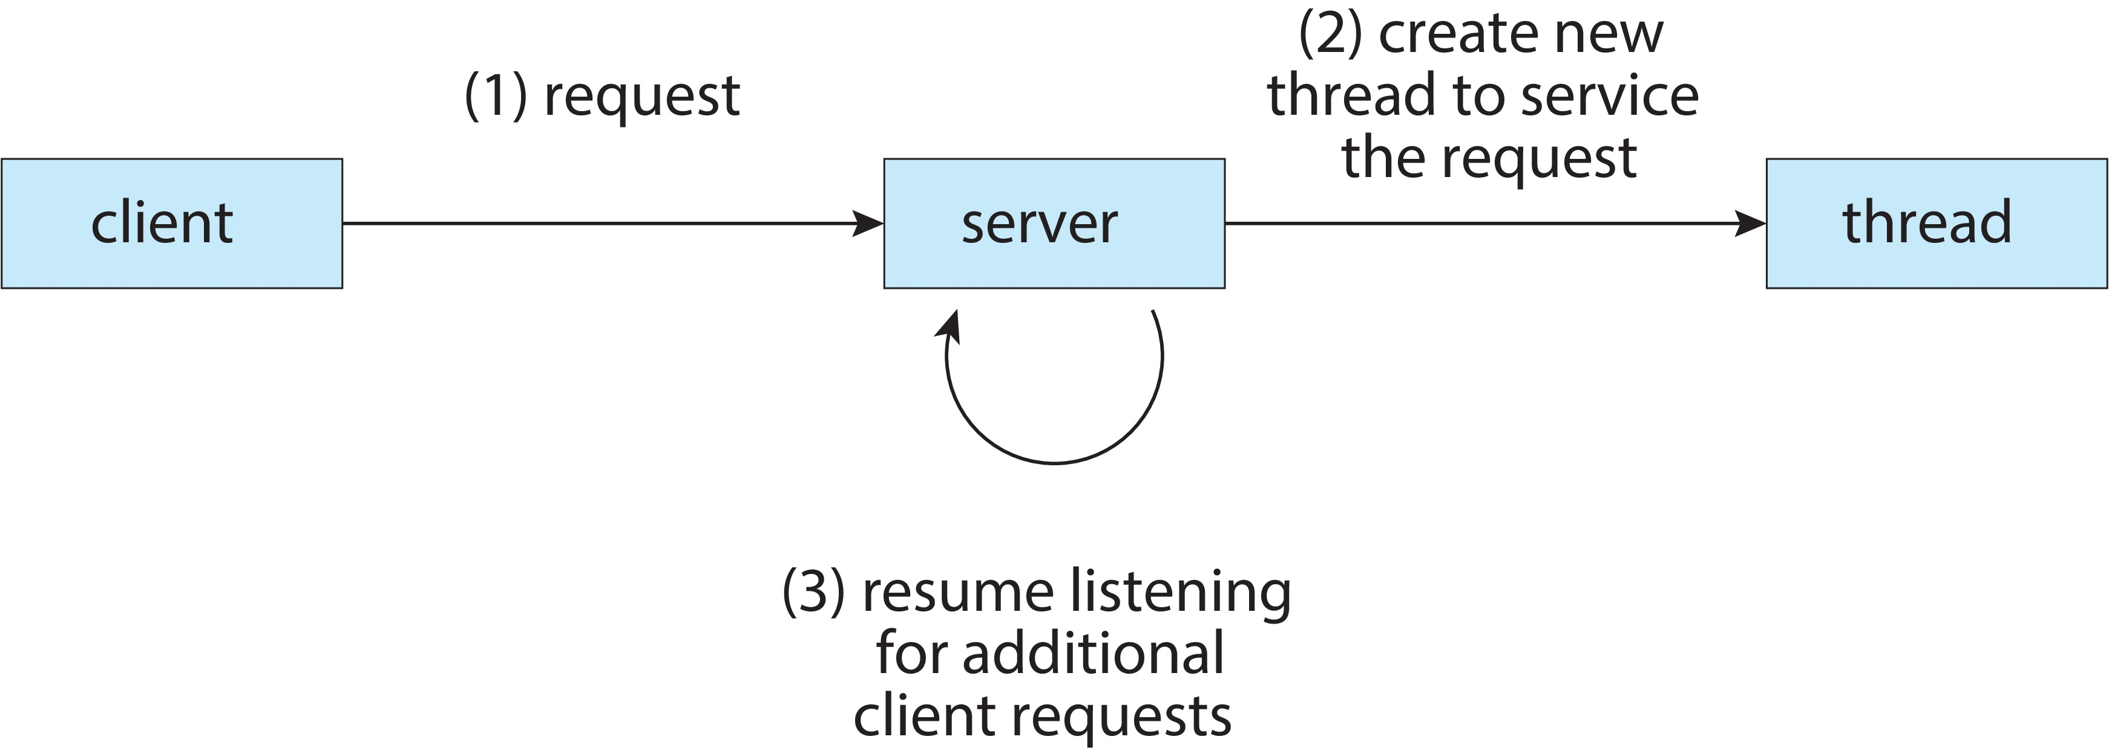
Multithreaded Server
19

Slide 20


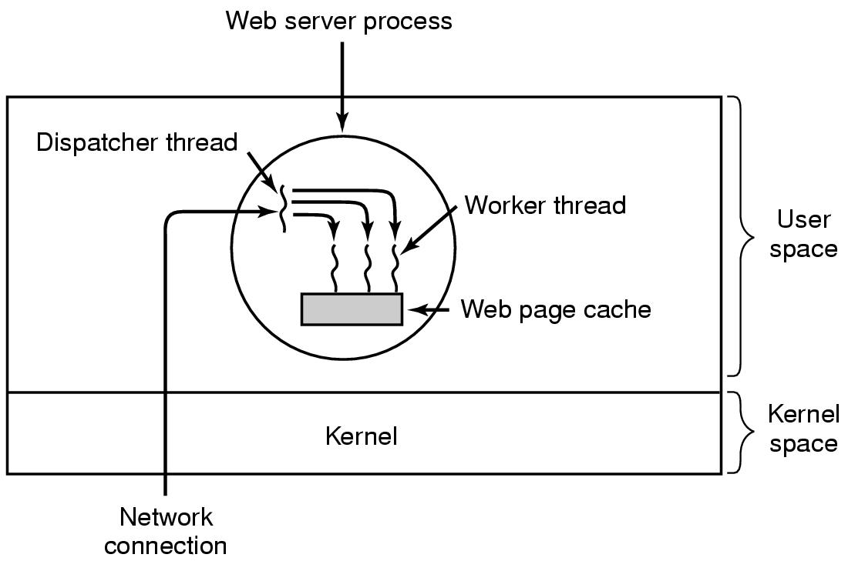
Multithreaded Server
Requests for pages arrive
Each request handled by a different thread
Thread sends the page back to client
20
Notes:
Thread Pool
Consider the example of web server. Issues in such scenarios are:
Amount of time to create thread.
If we have too many requests the unlimited threads will be created and system resources could be exhausted.
Solution is thread pool
Idea
No of threads are created at time of process start up and are placed into a pool where they sit and wait.
When a server receives a request, it awakens a thread from this pool and passes it the request to service.
Once finished, a thread returns to the pool and wait.

Slide 21
Multithreaded Server
Dispatcher thread reads incoming requests from N/W
  chooses an idle worker thread
  wakes up the worker – blocked to ready state
  hands over the request
Worker now checks if request can be met from Web page cache, to which all threads have access
  if not, starts a read() operation, to fetch page from disk
    worker blocks until disk read completes
  when thread blocks on disk, another thread chosen to run
    possibly the dispatcher, to acquire more work, or
    another worker that is now ready to run
21
Notes:
Thread Pool
Consider the example of web server. Issues in such scenarios are:
Amount of time to create thread.
If we have too many requests the unlimited threads will be created and system resources could be exhausted.
Solution is thread pool
Idea
No of threads are created at time of process start up and are placed into a pool where they sit and wait.
When a server receives a request, it awakens a thread from this pool and passes it the request to service.
Once finished, a thread returns to the pool and wait.

Slide 22
  User & Kernel Level Threads
22

Slide 23
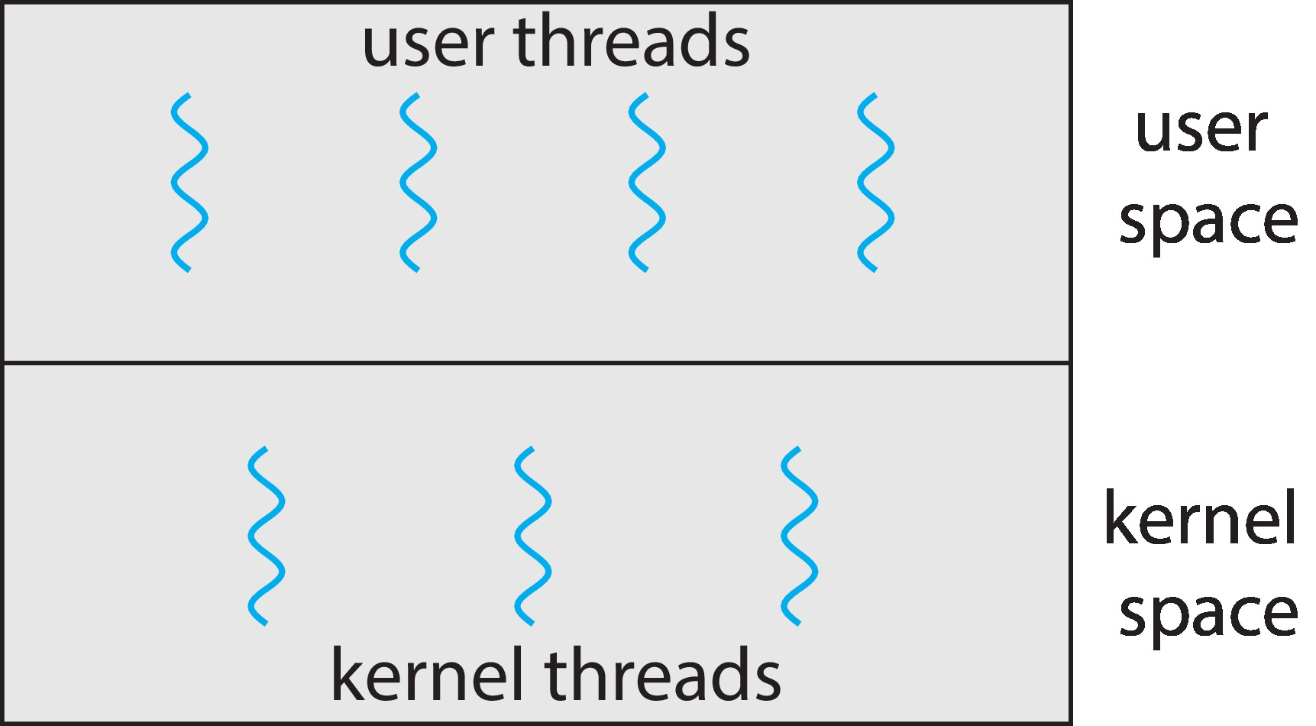
User & Kernel Threads
Support for threads is provided at User and Kernel levels
User threads
  User threads are created, scheduled, & managed by user level thread library
  Primary thread libraries: POSIX pthreads, Windows threads
Kernel threads
  Kernel threads are created, scheduled, & managed by OS kernel
  (OS specific APIs, libraries)
  All general-purpose OS have
  kernel threads
  Windows, Linux, iOS, Android,
  Mac OS X
23

Slide 24
User Level Threads
Application starts as single thread, in a process managed by Kernel
  may spawn new threads in same process – thread library
User level thread libraries contain code for:
  thread creation & termination
  thread scheduling, saving/restoring thread context
  passing data/messages between threads
User threads are lightweight, & have lower overhead
  management at user level, no direct involvement of kernel
  context switch between user threads is faster
  user-mode register values stored in thread control block (user space)
If one user thread makes a system call that blocks (I/O operation)
  entire process gets blocked
  kernel unaware that user level threads exist in process
24

Slide 25
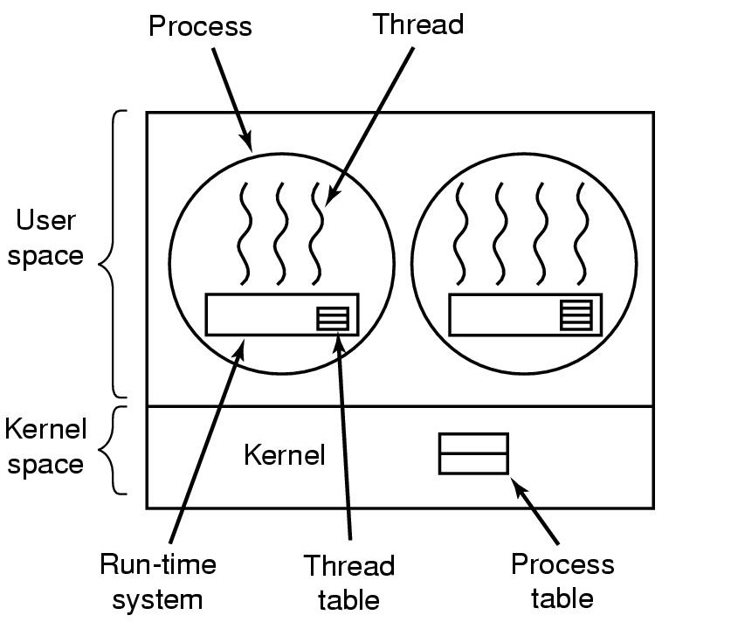
Implementing Threads in User Space
Thread management done in user space
by library
Thread control block maintained in user space
Kernel knows nothing about user threads
User-level Threads
25

Slide 26
Kernel Threads
Thread creation & management done by OS kernel
  Kernel is aware of threads
Kernel threads are typically heavier than user threads, in terms of overhead
  requires kernel involvement for thread creation, scheduling, switching, and management
  (kernel-level data structures & privileged operations)
Blocking does not affect other threads in the process
  if one kernel thread blocks, other kernel threads continue
Each kernel thread can be scheduled independently on one or more CPUs
  good for parallelism / concurrency
26

Slide 27
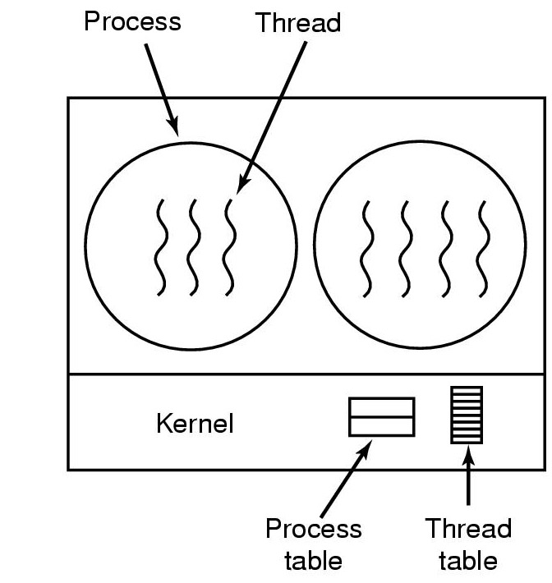
Implementing Threads in Kernel
OS knows about individual threads within each process
Thread control block maintained by kernel
Kernel-level Threads
27

Slide 28
Thread Implementation Models
A relationship exists between User level threads and Kernel level threads
  three common models of this relationship:
  (1:1, M:1, & M:N)
28

Slide 29
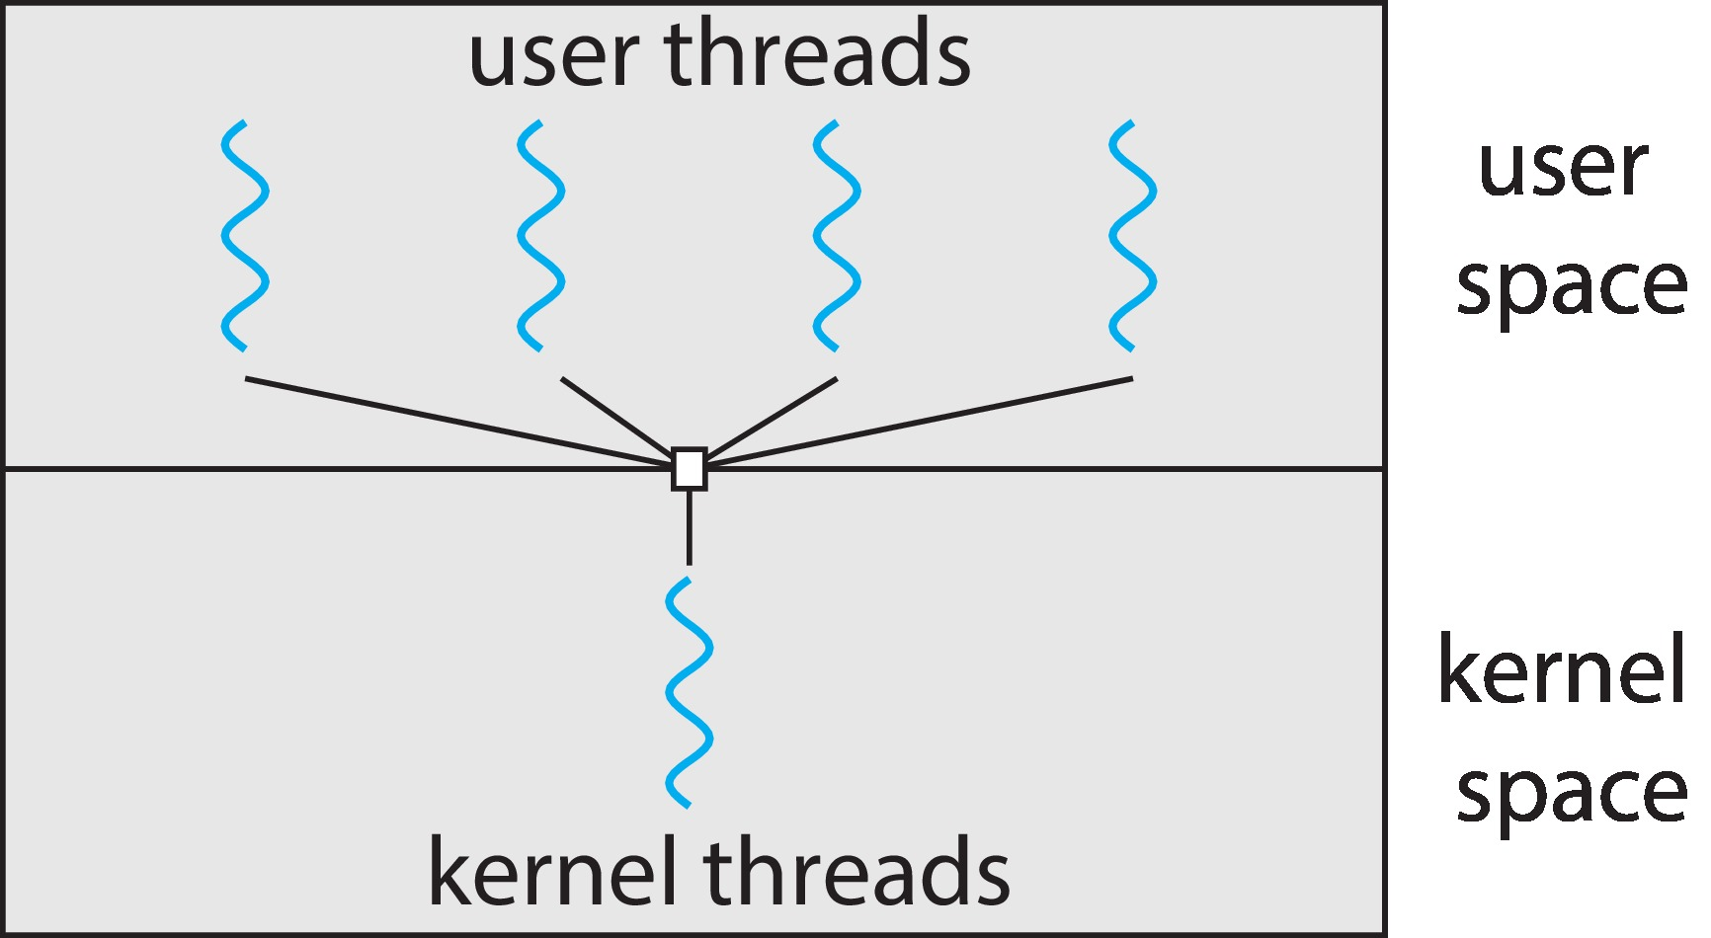
Many-to-One Model (M:1)
Many user-level threads map to a single kernel thread
Kernel unaware of multiple threads within the process
  kernel schedules only the one kernel thread
  thread library then schedules user threads within given time slice
  if one user thread blocks, causes entire process to block
  no scheduling of multiple threads on CPUs in multicore systems
User level threads can be used, even if OS does not support multithreading
Hardly any systems currently
use this model
29

Slide 30
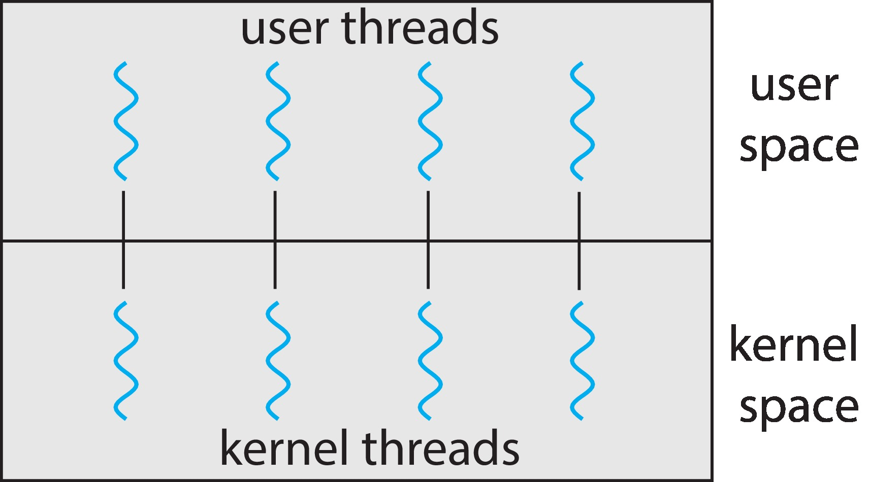
One-to-One Model (1:1)
Each user-level thread maps to one kernel thread
  creating a user level thread creates a kernel thread
Kernel is aware of multiple threads within the process
  when one thread in a process blocks, another is run
  multiple threads can run in parallel on multiprocessors
Creating kernel threads can overburden the application
  number of threads per process sometimes restricted
Examples:
  Windows
  Linux
30

Slide 31
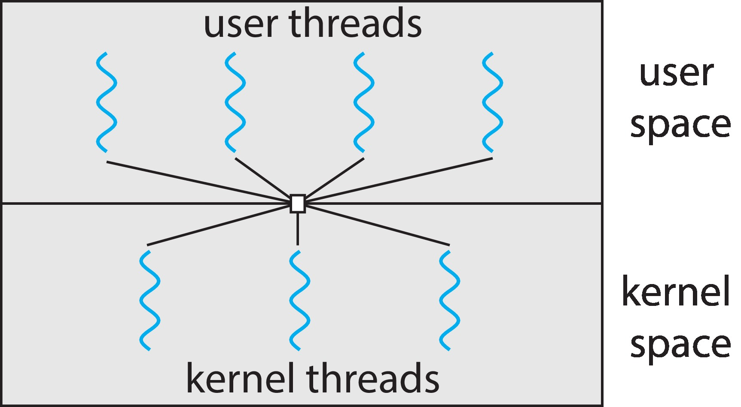
Many-to-Many Model (M:N)
Many user level threads are mapped to a smaller or equal number of kernel threads
  OS can create sufficient number of kernel threads
  aims to combine advantages of models – (many:1) & (1:1)
Model does not suffer from:
  concurrency issue of many:1 model
  overhead burden of 1:1 model
But M:N model is more complex
  not very common
Example:
  Windows with ThreadFiber
  package
31

Slide 32
  Thread Libraries
32

Slide 33
Thread Libraries
Thread libraries provide programmers with API for creating & managing threads
  two primary ways of implementing
  library entirely in User space, or Kernel-level library
Pthreads
  POSIX standard API for thread creation & synchronization
  Unix type systems; Linux, Solaris, Mac OS X
Windows Threads
  Windows threads library uses techniques similar to Pthreads
Java Threads
  Java threads available on any system that provides JVM –
  Windows, Linux, Mac OS X, Android
33

Slide 34
Important POSIX System Calls
Call | Description
pthread_create () | Similar to fork ()
pthead_join () | Similar to waitpid ()
pthread_exit (void *status) | To terminate a thread
Thread operations include:
  thread creation, termination, synchronization (joins, blocking), scheduling, data management, & process interaction
Thread does not maintain a list of other created threads, nor does it know the thread that created it
34

Slide 35
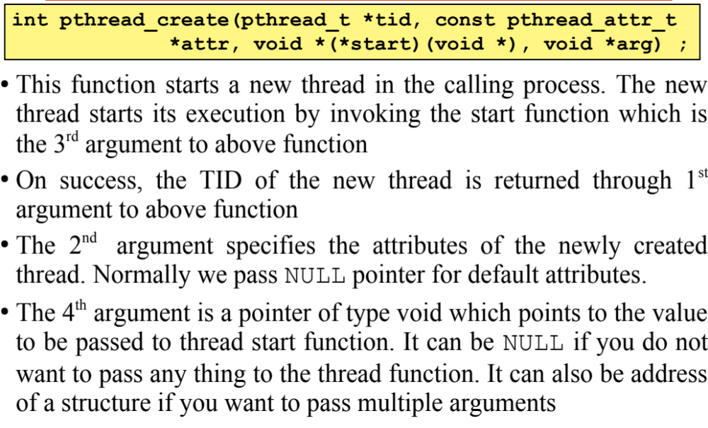
Thread Creation
35

Slide 36
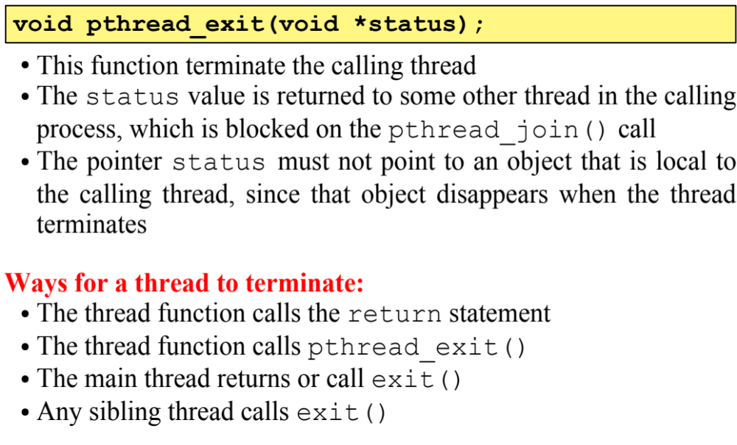
Thread Termination
36

Slide 37
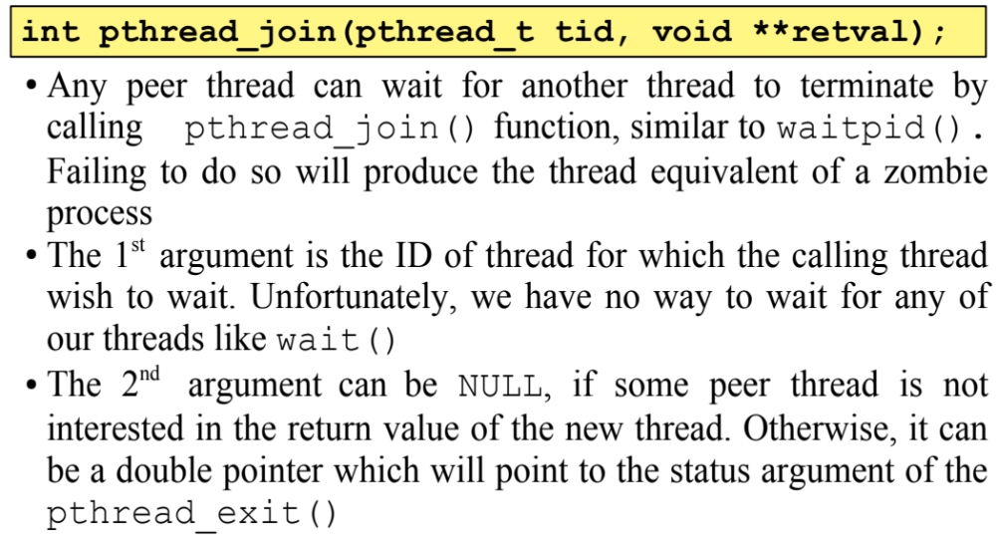
Joining a Thread
37

Slide 38
Example 0
void f1();
void f2();
int main(){
f1();
f2();
printf("\nBye Bye from main\n");
return 0;
}
void f1(){
for(int i=0; i<5; i++){
printf("%s", “UCP");
sleep(1);
}
}
void f2(){
for(int i=0; i<5; i++){
printf("%s", ”FOIT");
sleep(1);
}
}
38

Slide 39
Example 1
void* f1(void*);
void* f2(void*);
int main(){
pthread_t tid1, tid2;
pthread_create(&tid1, NULL, f1, NULL);
pthread_create(&tid2, NULL, f2, NULL); pthread_join(tid1, NULL);
pthread_join(tid2, NULL);
printf("\nBye Bye from main thread\n");
return 0;
}
void * f1(void * arg){
for(int i=0; i<5; i++){
printf("%s", “UCP"); fflush(stdout);
sleep(1);
}
pthread_exit(NULL);
}
void * f2(void * arg){
for(int i=0; i<5; i++){
printf("%s", “FOIT");
fflush(stdout);
sleep(1);
}
return NULL;
}
39

Slide 40
Compiling a multi-threaded Program
Multi-Threaded programs need to be linked with the thread library /usr/lib/libpthread.so
$ gcc -o t1 t1.c –pthread
$./t1
40

Slide 41
Example 2
int main(){
pthread_t tid1, tid2;
pthread_create(&tid1, NULL, f1, NULL);
pthread_create(&tid2, NULL, f2, NULL);
pthread_join(tid1, NULL);
pthread_join(tid2, NULL);
printf("\nBye Bye from main thread\n");
return 0;
}
void * f1(void * arg){
for(int i=0; i<1000;i++)
fprintf(stderr, "%c",'X');
pthread_exit(NULL);
}
void * f2(void * arg){
for(int i=0; i<800;i++)
fprintf(stderr, "%c",’O');
pthread_exit(NULL);
}
41

Slide 42
Example 3
int main(int argc, char* argv[]){
int countofX = atoi(argv[1]);
int countofO = atoi(argv[2]);
pthread_t tid1, tid2;
pthread_create(&tid1, NULL, f1, (void*)&countofX); pthread_create(&tid2, NULL, f2, (void*)&countofO);
pthread_join(tid1, NULL);
pthread_join(tid2, NULL);
printf("\nBye Bye from main thread\n");
return 0;}
void * f1(void * arg){
int ctr = *((int*)arg);
for(int i=0; i<ctr; i++)
fprintf(stderr, "%c", 'X');
pthread_exit(NULL);
}
void * f2(void * arg){
int ctr = *((int*)arg);
for(int i=0; i<ctr; i++)
fprintf(stderr, "%c", ’O');
pthread_exit(NULL);}
42

Slide 43
Example 4
struct mystruct{
char character; int count;
};
void * f1(void *);
int main(){
pthread_t tid1, tid2;
struct mystruct t1_args, t2_args;
t1_args.character = 'X'; t1_args.count = 1000; pthread_create(&tid1, NULL, f1, (void*)&t1_args);
t2_args.character = 'O'; t2_args.count = 800;
pthread_create(&tid2, NULL, f1, (void*)&t2_args);
pthread_join(tid1, NULL);
pthread_join(tid2, NULL);
printf("\nBye Bye from main thread.\n"); return 0;}
void * f1(void * args){
struct mystruct p = *(struct mystruct*)args;
for (int i = 0; i < p.count; i++)
putc(p.character,stdout);
pthread_exit(NULL);
}
43

Slide 44
Example 5
int main(int argc, char* argv[]){
if(argc != 3){
printf("Must pass two file names.\n");
exit(1);
}
pthread_t tid1, tid2;
pthread_create(&tid1, NULL, func, (void*)argv[1]);
pthread_create(&tid2, NULL, func, (void*)argv[2]);
pthread_join(tid1, NULL);
pthread_join(tid2, NULL);
printf(”Bye Bye from main thread\n");
return 0;
}
void* func(void* args){
char* filename = (char*)args;
int ctr = 0; char ch;
int fd = open(filename, O_RDONLY);
while((read(fd, &ch, 1)) != 0) ctr++;
close(fd);
printf("Characters in %s: %d\n", filename, ctr);
pthread_exit(NULL);}
44

Slide 45
  Threads Issues
45

Slide 46
fork() in Multithreading
If one thread calls fork() in a multithreaded program…
Only calling thread duplicated
  issues – child has inconsistent state – abandoned locks, incomplete operations, shared data in undefined conditions
All threads in parent duplicated
  issues – identical thread copies with shared kernel objects would operate independently in both parent/child
POSIX standard – Only the calling thread is duplicated
  clean up & reinitialize shared state before any other operations
  call exec() immediately after fork() to replace entire address space
Best Practice : avoid fork() with threads, or use fork() before creating threads
46

Slide 47
exec() in Multithreading
Behavior of exec()in multithreading environment…
If a thread invokes exec()
  program speciﬁed in parameter to exec() will replace the
  entire process — including all threads
  any threads running before calling exec(), are terminated
  as new program over-writes process memory, all global variables disappear
    including all pthread objects (mutex, condition variables)
47

Slide 48
Thread Cancellation
A thread can send a cancellation request to another thread to terminate before it has completed
  Example: if multiple threads concurrently search a DB, and one thread returns result, remaining threads may need to be canceled
  thread to be canceled is target thread
Target thread cancellation may be done in two ways…
  Asynchronous cancellation
    target thread gets terminated immediately
  Deferred cancellation
    target thread checks for pending cancellation requests at specific cancellation points
    allows itself opportunity to terminate in orderly fashion
48

Slide 49
Thread Cancellation
A thread can request that another thread be cancelled…
  int pthread_cancel( pthread_t tid )
  (mentions TID of target thread)
Cancellation may cause a problem, if target thread holds resources that it must free later
  So, a thread can set its state as cancellable or un-cancellable
  pthread_setcancelstate()
Cancellable thread may also set its cancellation type, as:
  Asynchronous – cancelled at any point during execution
  Deferred – cancellation request is queued, until target
  thread reaches next cancellation point
  pthread_setcanceltype()
49

Slide 50
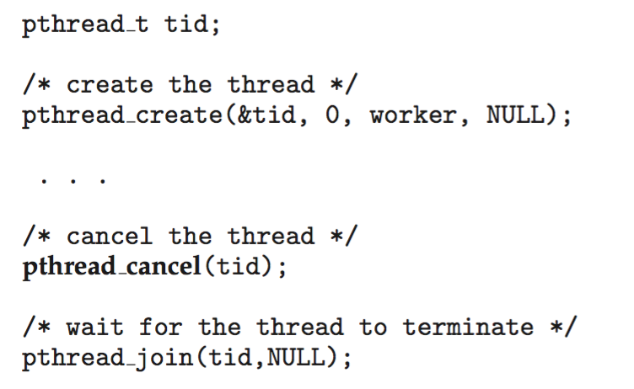
Thread Cancellation
Pthread code to create & cancel a thread:
50

Slide 51
Explicit & Implicit Threading
Explicit Threading
  threads are explicitly created & managed using thread libraries
  programmer decides where / when to create threads, and how to synchronize & communicate between threads
  provides more control over thread management
    but needs more effort
Implicit Threading
  creation & management of threads done by compilers and
  runtime libraries
    based on program's structure
  simplifies programming by automating thread management
    but may be less flexible
51

Slide 52
Explicit & Implicit Threading
Approaches to Implicit Threading
Thread Pools
  use of existing threads from the pool
  faster than creating new ones
OpenMP
  threads created by runtime system
  programmer defines parts of code to be parallelized
  OpenMP generates necessary code to create and manage threads accordingly
Grand Central Dispatch
  similar to OpenMP, for Mac OS X and iOS
52

